Slide 1
Presentation-01
Course title: Theory of Computation
Group Members:
Sazid Mahmud Emon Khan (202122104005)
Debodyan Deb (202122104007)
Tanima akter (202122104011)
Md. Ehasan Mahmud (202122104026)
Meherab Hossen (202122104028)
Saki Al Muiz Drubo(202122104030)

Slide 2
Definition of Automata
An "automaton" is essentially a self-operating machine that follows a predetermined sequence of operations. In theory, these machines can represent mathematical models of computation.
Automata Theory aims to understand and classify different computational models based on their sequential or parallel processing capabilities, symbolic density and many other factors.

Slide 3
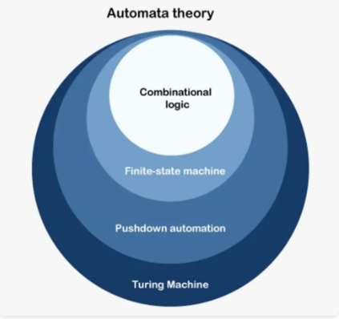
Key Concepts in Automata Theory

Slide 4
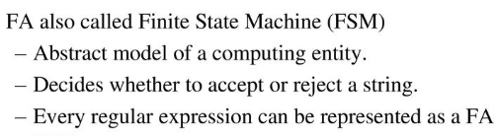
(FA)
There are two types of finite automata:
1.DFA(deterministic finite automata)
2.NFA(non-deterministic finite automata)

Slide 5
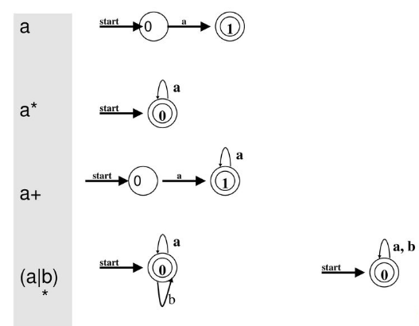
Simple example of FA

Slide 6
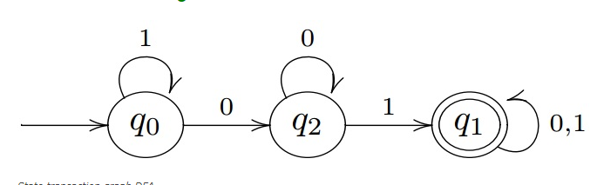
Deterministic finite automaton
In the theory of computation, a deterministic finite automaton (DFA) is a finite-state machine that accepts or rejects a given string of symbols, by running through a state sequence uniquely determined by the string
DFA uses include protocol analysis, text parsing, security analysis, CPU control units and natural language processing.
Example of DFA:

Slide 7
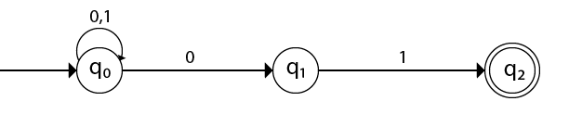
Non-deterministic Finite Automata
Non-deterministic finite automata (NFAs) are computational models that simulate systems that can be in multiple states at once. They are used in computer science to understand concepts like regular languages and automata theory.
Example of NFA:

Slide 8
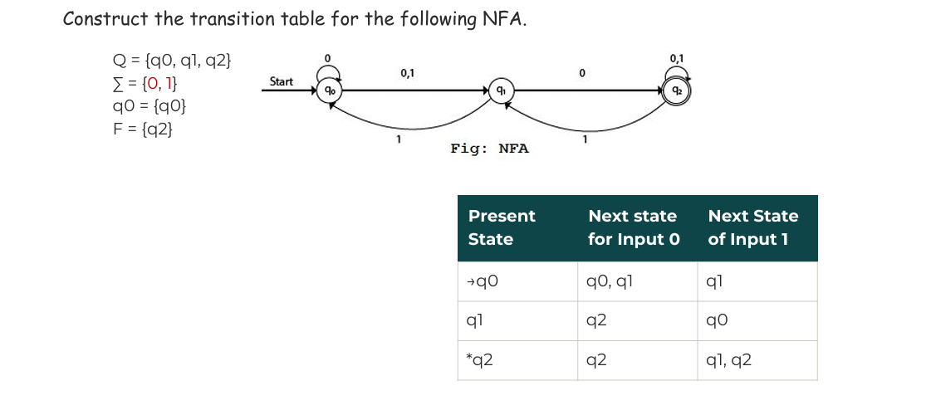
NFA Transition Table:
Q= set of all states epsilon= input alphabets q0=start states F=set of final states

Slide 9
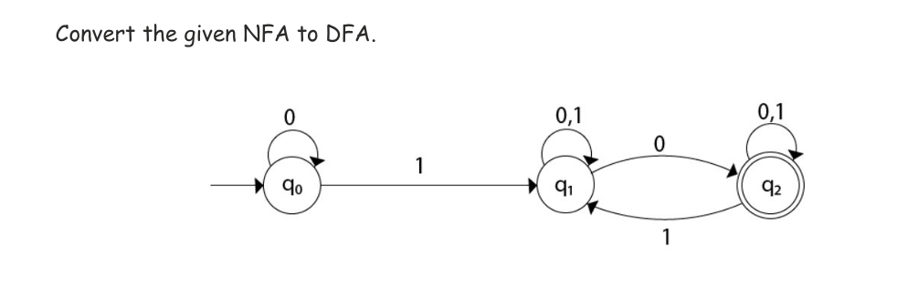
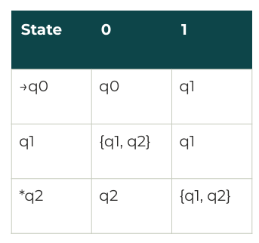
NFA to DFA Convert:
Solution:
NFA table

Slide 10
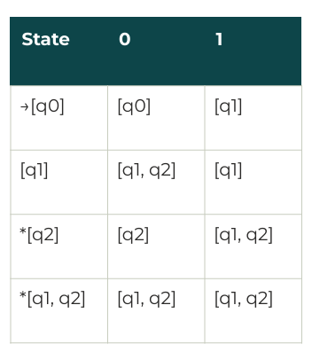
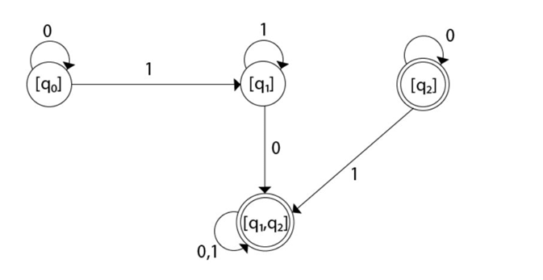
DFA table
Final diagram of DFA:
δ’([qx,qy],0)=δ(qx,0) U δ(qy,0)

Slide 11
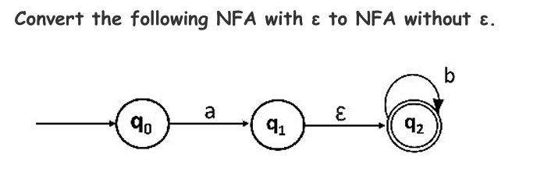
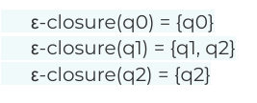
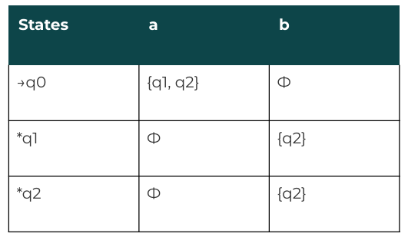
δ’([qx,qy],0)=δ(qx,0) U δ(qy,0)
Eliminating ε Transitions from NFA:
Solution:
δ | a | b
q0 | q1 | Φ
q1 | Φ | Φ
*q2 | Φ | q2
Table of NFA without epsilon:
Table of Epsilon-NFA

Slide 12
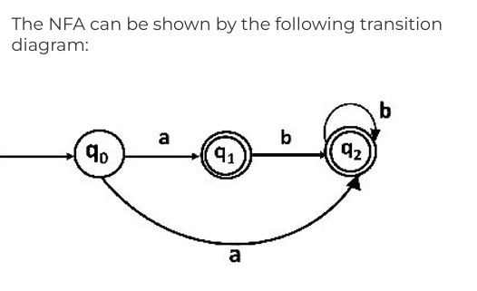
Final NFA diagram without epsilon:

Slide 13
ε-NFA to DFA:
ε- closure(1)={1,3} ε- closure(2)={2}
ε- closure(3)={3}
1
b
ε
a
a,b
2
a,b
3
Solution:
[ Initial state for DFA= ε- closure(1)={1,3} ]
DFA Table:
δ | a | b
1 | Φ | {2}
2 | {2,3} | {3}
3 | {1} | Φ
states | a | b
{1,3} | {1,3} | {2}
{2} | {2,3} | {3}
{2,3} | {1,2,3} | {3}
{3} | {1,3} | Φ
{1,2,3} | {1,2,3} | {2,3}
Table of Epsilon-NFA

Slide 14
Final DFA diagram :
Φ
b
a,b
3
2
b
b
b
a
a
2,3
a
1,2,3
1,3
a
b
a

Slide 15
Regular Expression o NFA:
(ab U a)*
Solution:
a:
a
b:
b
a
ε
b
ab:
a
ε
b
(ab U a):
ε
a
ε

Slide 16
(ab U a)*:
ε
a
ε
b
ε
ε
a
ε
ε
ε

Slide 17
Regular Expression ​
What is a Regular Expression?​ A regular expression (regex) is a sequence of characters defining a search pattern, mainly used for pattern matching in strings. Importance in Theory of Computing Represents patterns in formal languages.​
Basis for lexical analysis in compilers. Applications of Regular Expressions​
Text Search and Validation (e.g., emails, passwords).​
String Manipulation (e.g., find, replace).​
Lexical Analysis (e.g., compilers).​
Data Extraction from logs, files, etc.​

Slide 18
Components of Regular Expressions​ ​
Basic Constructs-Characters: a, b, c​
Concatenation: ab​
Union (OR): a U b​
Kleene Star: a*​
Special Symbols.: Matches any character.​
^ and $: Anchors for the start and end of a string.​
[]: Character classes (e.g., [a-z]).
Tools for Regular Expressions​
Programming Languages: Python, Java, etc. Online Regex Tools: Regex101, Reg Exr. IDE Support: Visual Studio Code, IntelliJ.​

Slide 19
What is Arden’s Theorem?​
Arden's theorem provides a method to find a regular expression corresponding to the language accepted by a finite automaton. It solves equations of the form:​
R=Q+RP​
Where:​
R: The unknown regular expression.​
Q: A regular expression that does not depend on R.​
P: A regular expression that depends on R.​

Slide 20
Theorem Statement​
If P does not contain ε (empty string), the equation R=Q+RP has the unique solution:​ R=QP*​
Regular expression is a vital tool for pattern matching and automata theory.

Slide 21
Thank You!

